Slide 1
Notes:
This presentation will help to show your audience that there is much more to sharks that just sharp teeth. We have included 5 fun facts, that are sure to surprise, entertain and educate. Feel free to change or add your own interesting facts.
For more interesting shark facts, go to: http://www.supportoursharks.com/en/News/Miscellaneous/Articles/20130604/Did_you_know.htm

Slide 2
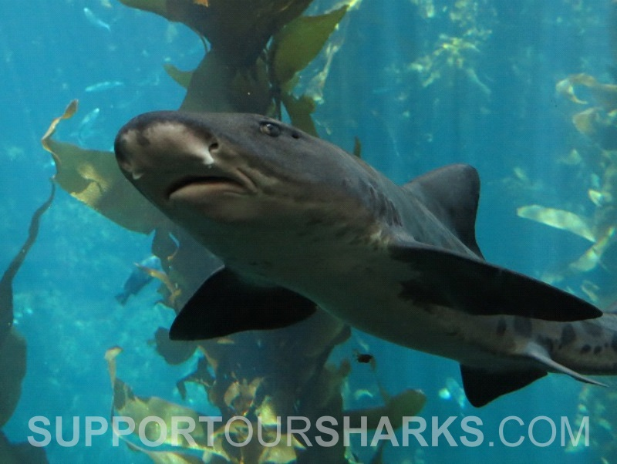
Notes:
Here, we have summarised 5 top shark facts. You are, of course, welcome to add more, but we feel like these represent some of the most awesome reasons why sharks are so cool.
Be sure to read the information attached to each slide for additional reading and links to useful resources.

Slide 3
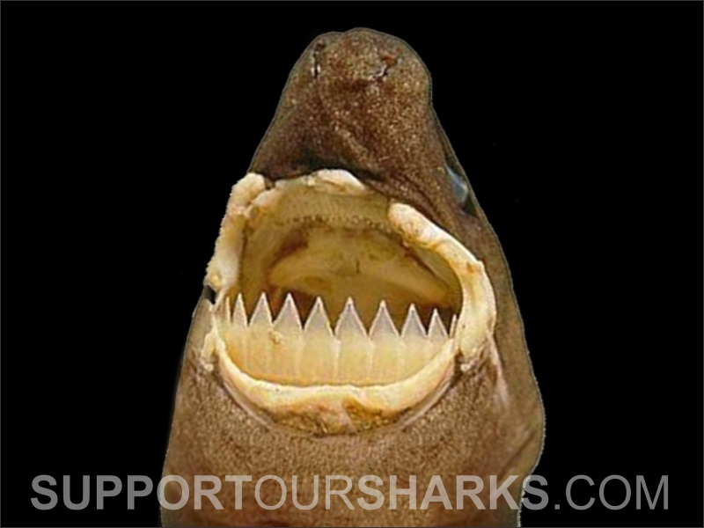
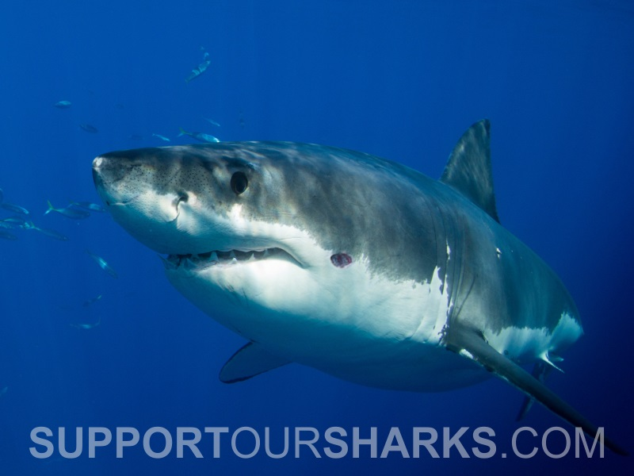
Some sharks can predate on animals over 100x their size
Notes:
The first photo on the slide shows a Great Whit shark with a bite from a small cookie cutter shark. Cookie cutter sharks are known to bite animals much larger than them, as they are very quick and able to cut out a chunk of flesh (like a cookie cutter) and swim away very quickly, before the bitten animal even realises. Cookie cutter sharks are known to bite larger sharks, whales, dolphins, tuna etc.
For more information: http://www.flmnh.ufl.edu/fish/gallery/descript/cookiecuttershark/cookiecuttershark.html

Slide 4
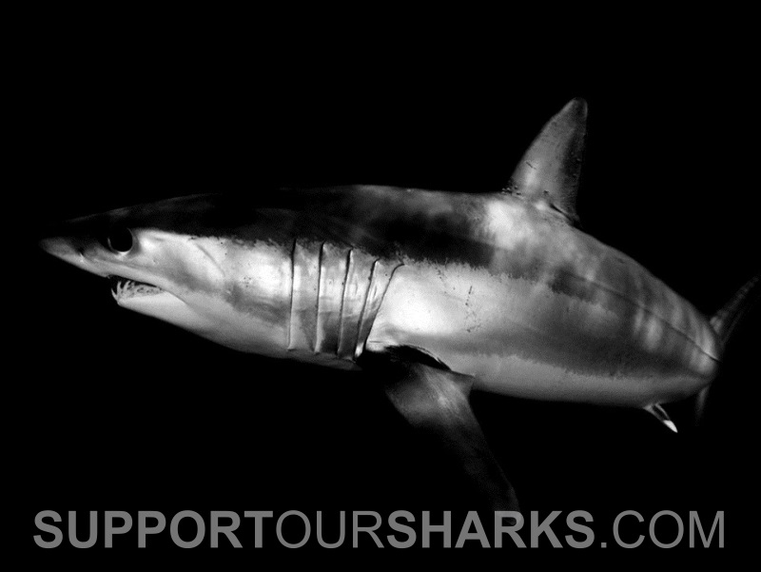
Sharks do not have
colour vision
Notes:
Despite popular belief that sharks may be attracted to the colour yellow (“yum yum yellow”), they are in fact colour-blind. It is the brightness of an object that determines whether they are attracted to it, rather than the colour itself.
More information: http://www.ncbi.nlm.nih.gov/pubmed/21212930

Slide 5
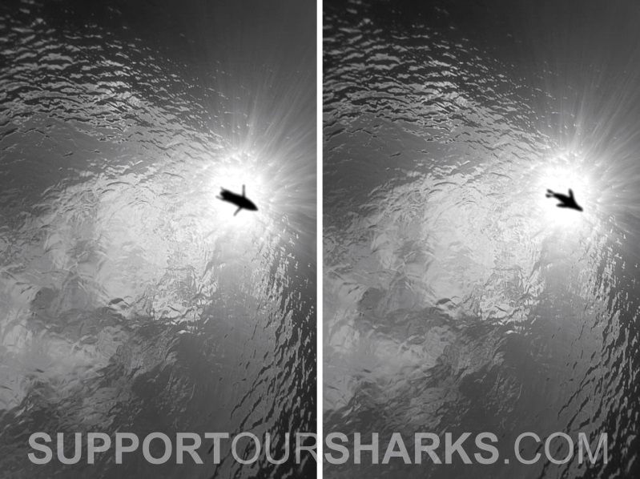
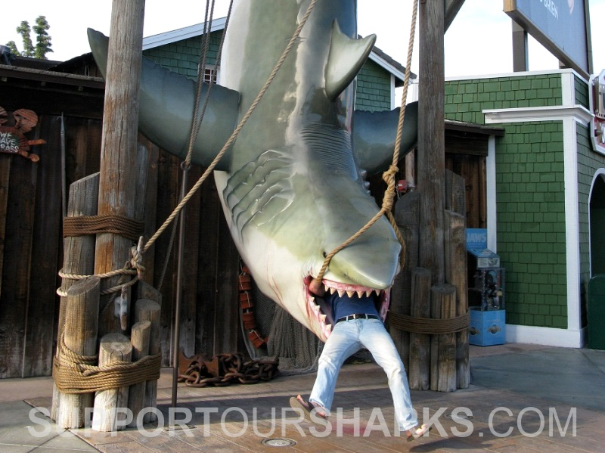
Sharks do not eat humans
Mistaken Identity?
Notes:
Sharks do NOT eat humans! But, in the case of a Great White shark, the bite can result in the loss of complete limbs due to the size of the shark’s mouth. Sharks very rarely continue to ‘attack’ someone once they have made an ‘exploratory bite’ (the first bite). After the first bite, sharks will determine if they have a suitable food source. Because large Great White sharks typically feed on seals/sealions etc. which are very fatty, they do not like the taste of humans, as we are mostly bone, and not much fat. Unfortunately, a single bite from a Great White shark is often enough to result in death.
It is very likely that Great White sharks mistake people on the surface (surfers/swimmers) with prey (ie: seals). Great White sharks can reach the surface (from a depth of 30m) in just 2.5 secs, so they don’t have much time to change their mind. Which means that once they have committed to biting something above them, there is little that will stop them.
For more information: http://rjd.miami.edu/research/projects/great-white-predation

Slide 6
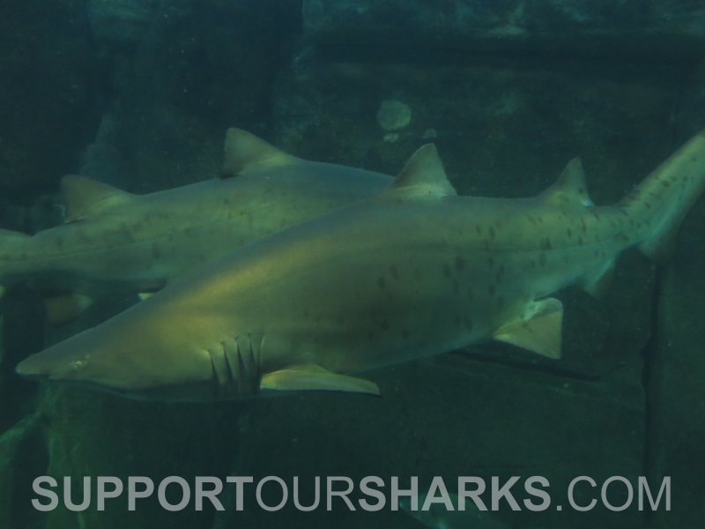
Some sharks will eat their siblings during development
Notes:
The process of shark embryos consuming their siblings in the womb is known as intrauterine cannibalism. It was discovered accidentally in 1948, when a researcher probing the uteri of a late-term Sandtiger shark (shown in the slide) was startled by a bite on the hand. This process allows the strongest embryos to survive to birth, and ensures that they have the best chance of survival.
For more information: http://www.supportoursharks.com/en/Education/Biology/Reproduction/Ovoviviparity.htm

Slide 7
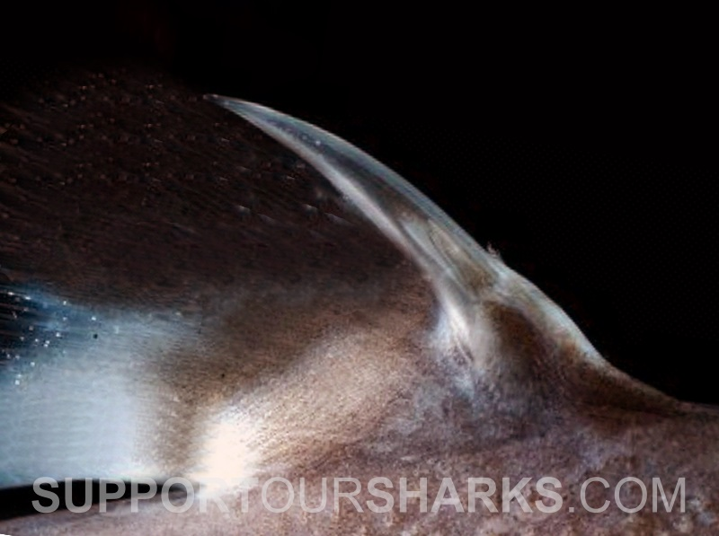
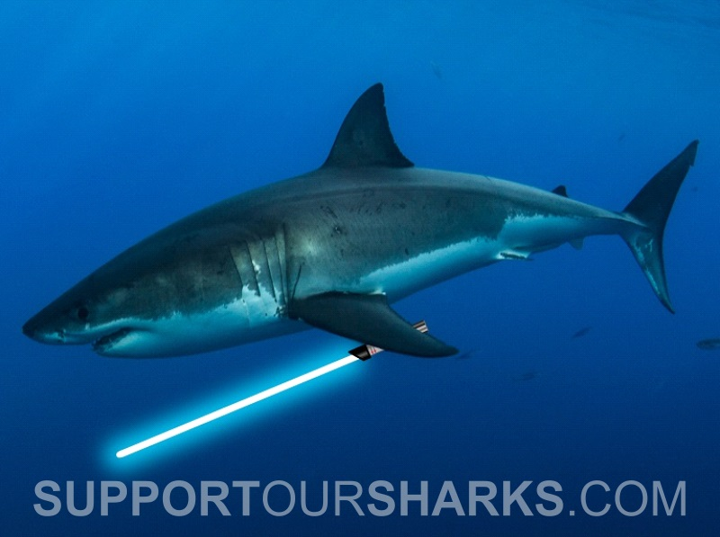
Some sharks scare off predators with ‘lightsabers’
Notes:
Unfortunately, this one doesn’t refer to Great White sharks holding lightsabers, which would be awesome! But, instead it is referring to some deep sea sharks that can illuminate the spines on their backs, like lightsabers, to warn potential predators that they could get a sharp mouthful if they attempt to bite them.
More information: http://www.bbc.com/news/science-environment-21531532

