Slide 1
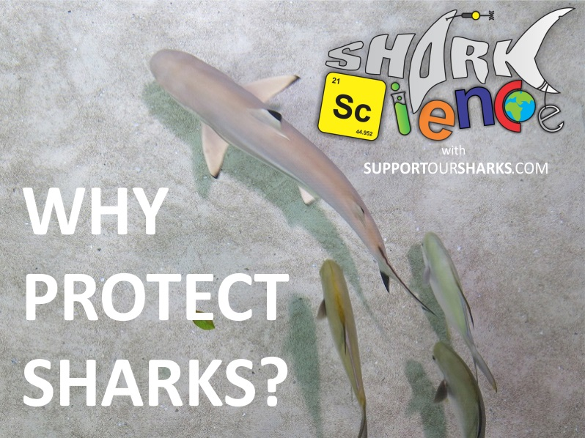
Notes:
After introducing the topic, you may wish to show one of our short videos that will help to explain some of the things that you will be discussing. A good video to use is the ‘Why Sharks Matter’ video which can be found on the Support Our Sharks website here: http://www.supportoursharks.com/en/Education/Videos.htm

Slide 2
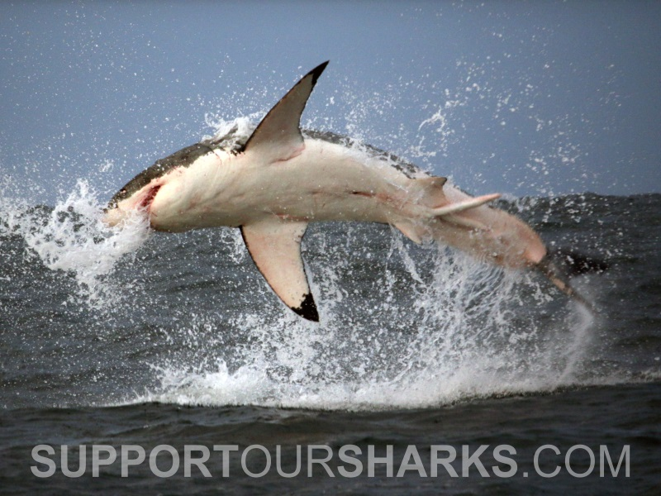
Notes:
Here, we have summarised 5 top reasons why we need to protect sharks. You are, of course, welcome to add more, but we feel like these represent some of the key reasons why sharks need our protection.
Be sure to read the information attached to each slide for additional reading and links to useful resources.

Slide 3
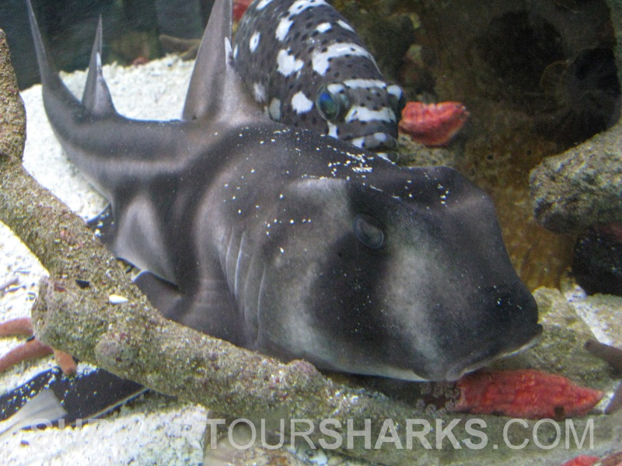
Sharks are one of the oldest
animals on the planet
Notes:
Sharks have been swimming in our oceans for over 400 million years. We know this thanks to the detailed fossil record compiled largely from fossilised shark teeth. As a shark’s skeleton is made up of mostly cartilage, rather than bone, their skeletons do not fossilise, therefore, the only remaining evidence of sharks is usually the teeth.
The photo on the slide is of a Port Jackson shark, which is part of one of the oldest group of shark species still alive today. This group of sharks, known as horn sharks, have been around for almost 300 million years.
After this slide you may want to show the video ‘How Long Have Sharks Existed?’, which can be found on the Support Our Sharks website here: http://www.supportoursharks.com/en/Education/Videos.htm
More information: http://www.supportoursharks.com/en/Education/Biology/Evolution.htm

Slide 4
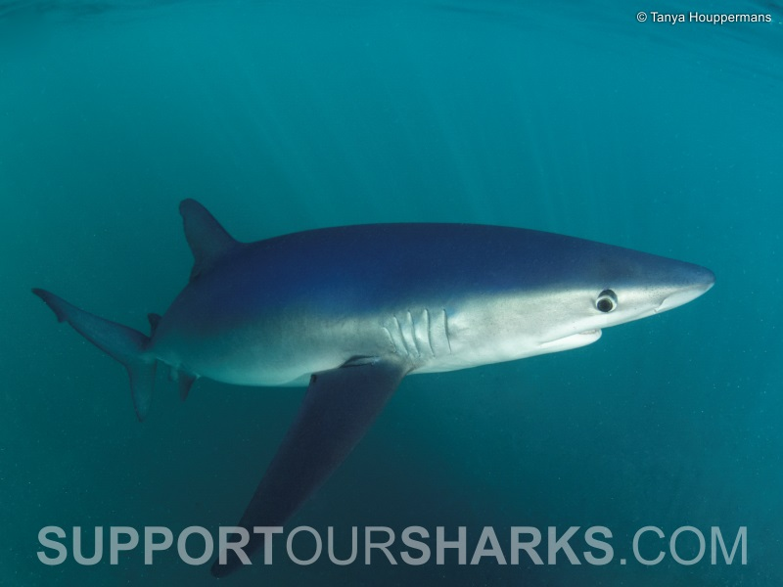
Shark meat contains
deadly toxins
Notes:
Marine organisms absorb toxins and heavy metals that enter the oceans from natural sources, such as volcanoes and the erosion of soils; more worryingly though, many of these toxins today originate from manmade sources, such as the burning of fossil fuels. These toxins accumulate through the food chain as one animal eats another, a process known as bioaccumulation. Bioaccumulation occurs when an organism absorbs a toxic substance at a rate greater than it can be removed. These toxins generally accumulate in the greatest quantities in large predatory animals, such as sharks, resulting in an amplification of their toxicity, known as biomagnification.
The effects of these toxins on predatory species, such as sharks, remains unclear, but what we do know is that they do not want them and will even resort to offloading toxins to their offspring in a desperate attempt to remove them. As many sharks are positioned at the top of the food chain, they are the final stop for many poisons in our oceans. Additionally, as some shark species live for more than 50 years, the levels of toxins built up in their bodies are often much greater than in any other marine organism.
After this slide you may want to show the video ‘Go Mercury Free’, which can be found on the Support Our Sharks website here:
http://www.supportoursharks.com/en/Education/Videos.htm
More information: http://www.supportoursharks.com/en/Conservation/SOS_Campaigns/Go_Mercury_free/About.htm

Slide 5
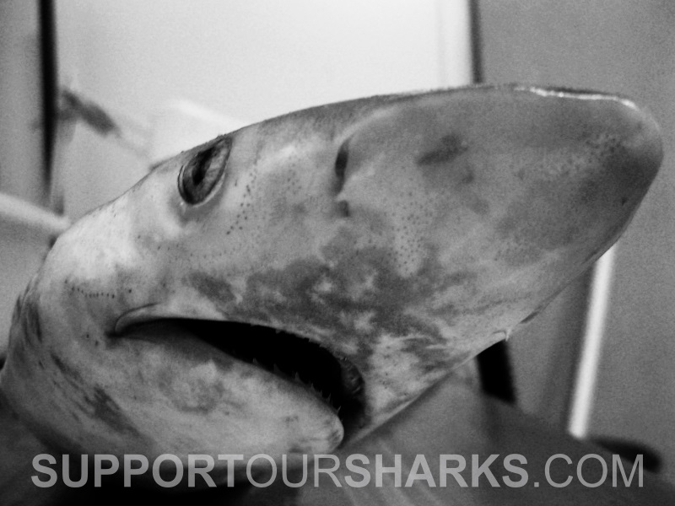
Sharks are being fished faster than they can recover
100 Million Sharks
Killed Every Year
Notes:
The most accurate assessment to date of the impact of commercial fishing on sharks suggests that between 63 and 273 million are being killed each year, with an average of approximately 100 million.
More information: http://www.supportoursharks.com/en/News/Miscellaneous/Articles/20130302/273_Million_Sharks.htm

Slide 6
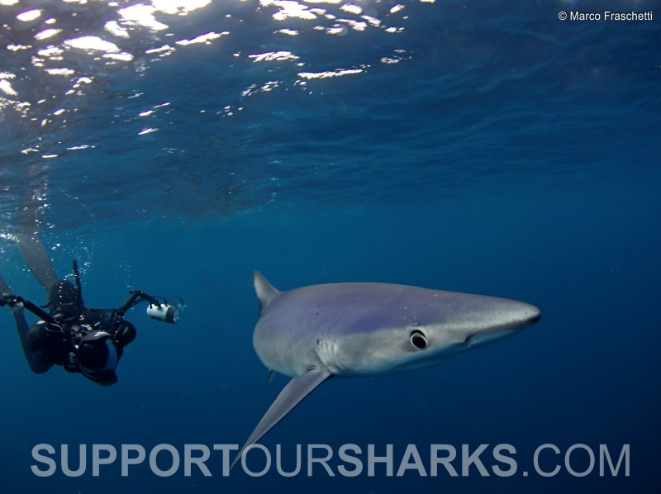
Sharks are worth
more alive
US$1.9 million Alive
US$108 Dead
Notes:
Researchers quantified the economic benefits of Palau's shark-diving industry and found that its value far exceeds that of shark fishing. In fact, the estimated annual value to the tourism industry of an individual reef shark that frequents these sites was US$179,000, or US$1.9 million over its lifetime. In contrast, a single reef shark would only bring an estimated US$108.
More information: http://www.pewtrusts.org/en/research-and-analysis/reports/2011/05/02/milliondollar-reef-sharks

Slide 7
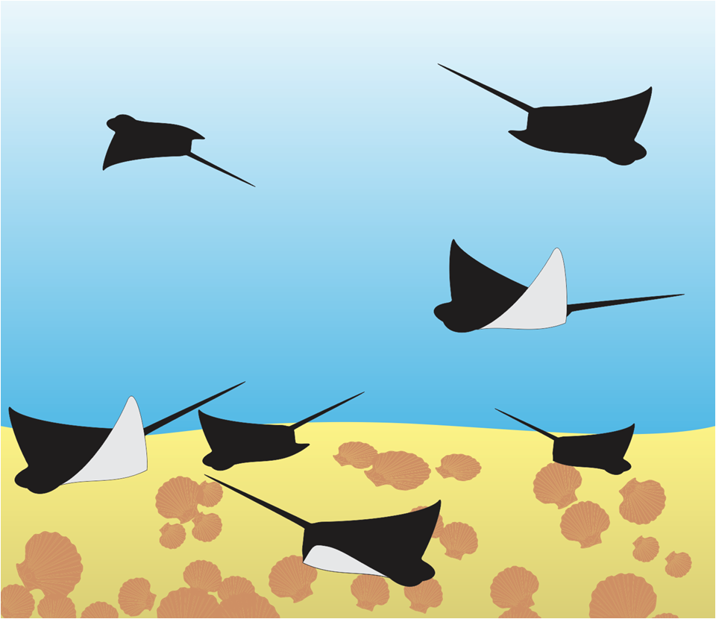
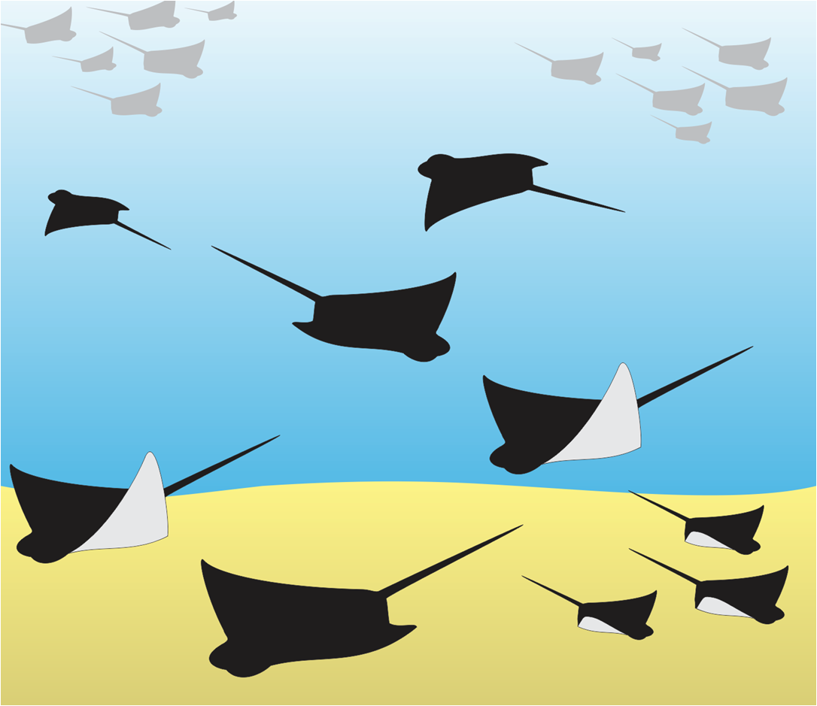
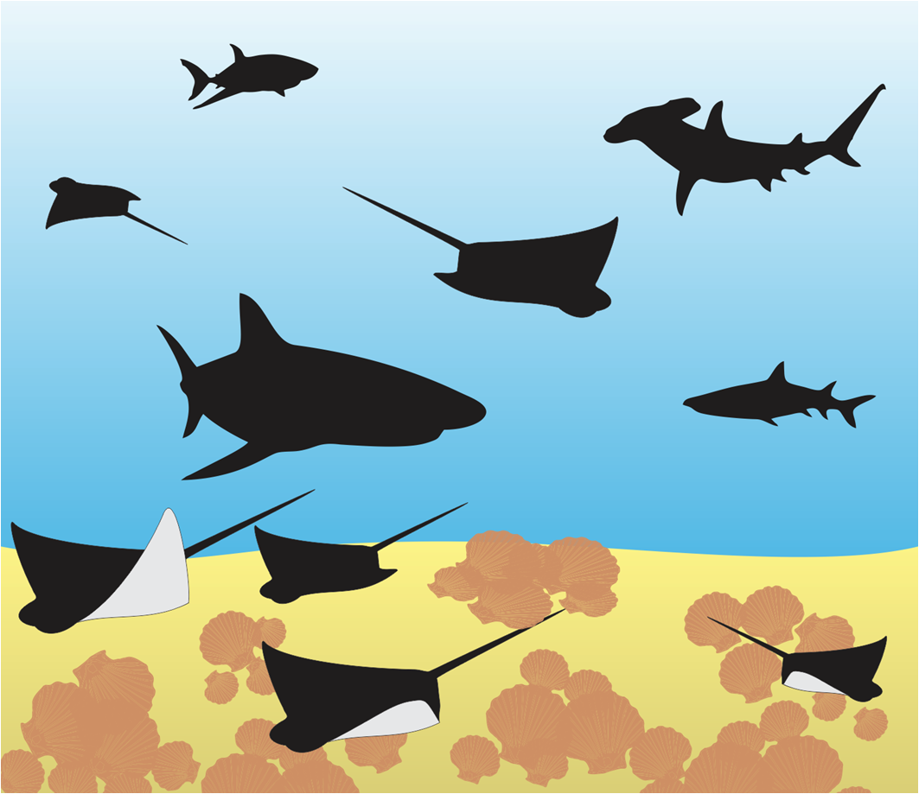
Killing sharks effects the
entire ecosystem
Notes:
Sharks play an important role in regulating a healthy balance between predators and prey, which ultimately helps to maintain a healthy and sustainable ecosystem. This slide depicts a real-life example of what happens when we remove sharks from an ocean ecosystem.
Researchers in Florida (USA) documented the decline of 11 shark species, known to predate on other elasmobranchs (rays, skates, and small sharks), over a 35 year period. As a result of the sharks decline, local prey species increased in abundance. The effects of this community restructuring resulted in an increase in the cownose ray population (once a typical prey species for the sharks), which then increased their predation on the bay scallops. Until this point, the bay scallops had been sustainably harvested by people for 100 years, but due to the increased predation by cownose rays, there were no longer enough scallops to harvest and the fishery had to close down.
This real-life example shows how removing sharks had a direct effect on food resources utilised by people.
More information: http://baumlab.weebly.com/uploads/1/2/4/4/12445281/myers_2007_science.pdf

